Slide 1
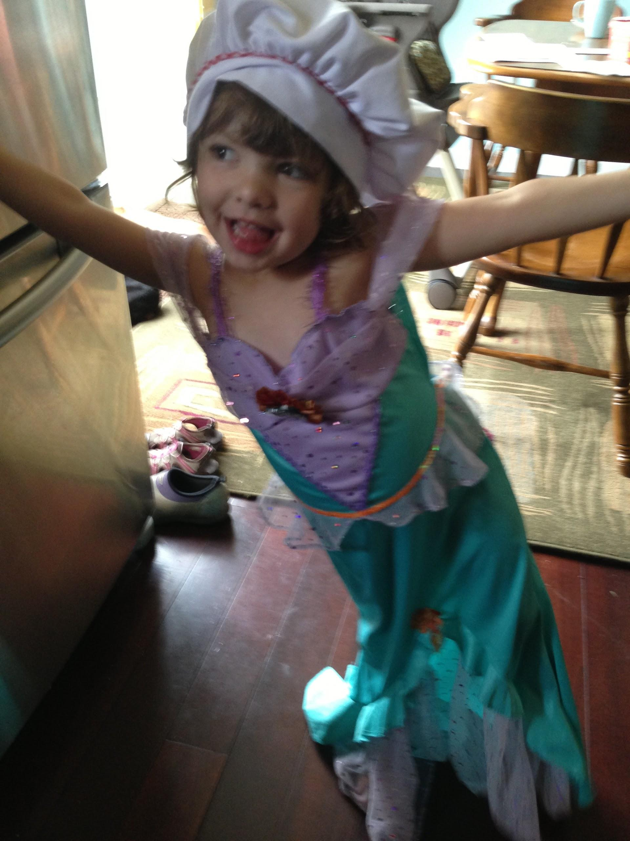
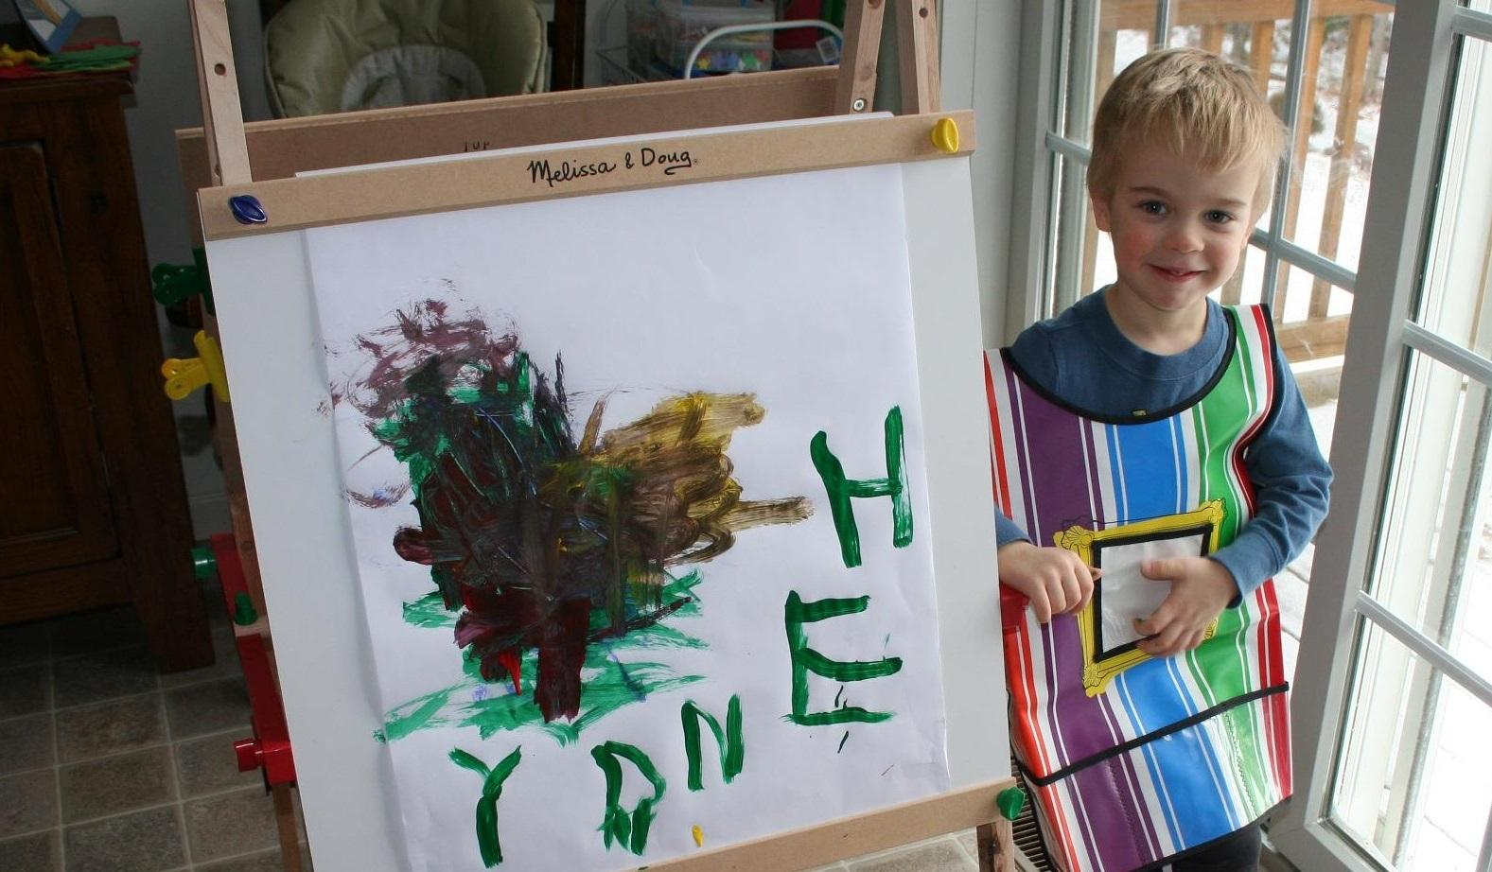
Making our own canvas: how we did a comprehensive review of our information literacy program

Slide 2
Anne Behler
Information Literacy Librarian
behler@psu.edu
@annielivre
John J Meier, Science Librarian
meier@psu.edu
@johnmeier1

Slide 3
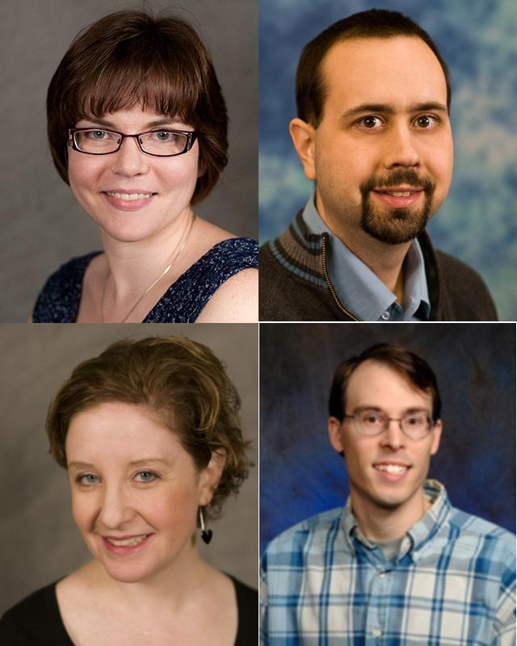
Library Leaders Program
2012/2013
Anne, Ellysa, John²
First Time / Experiment
Developed as we went

Slide 4
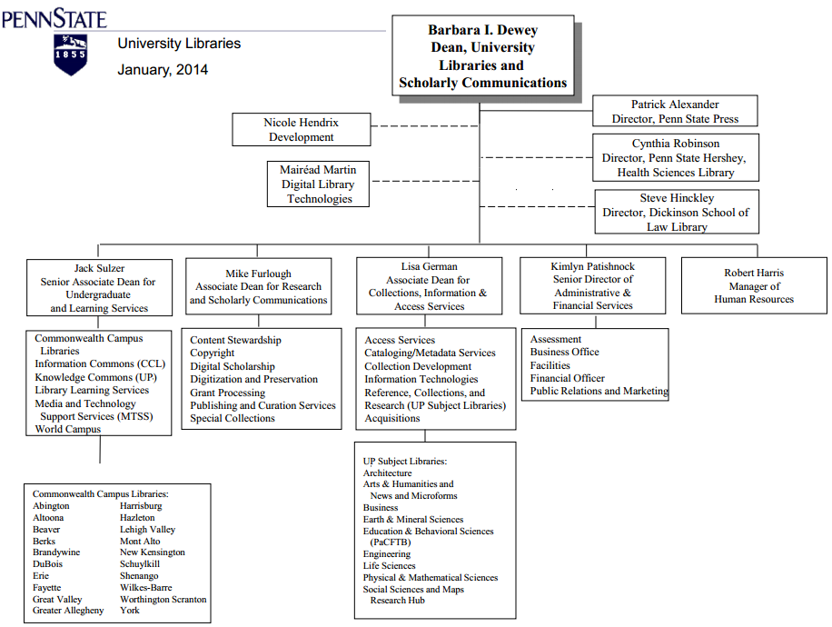
Anne is here
John is here

Slide 5
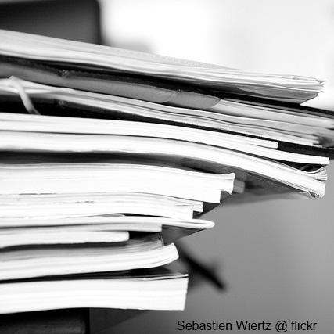
Consultative Study
Original proposal
Examine Tactical Plans
Develop recommendations
Draft implementation plan

Slide 6
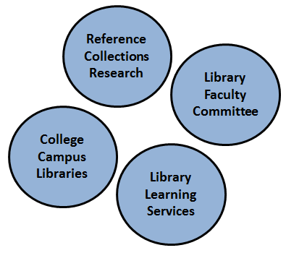
Counter-proposal
Negotiating scope
Our authority - acting as them
Added other stakeholders

Slide 7
Consultative Study (revised)
Our response
Benchmark peer libraries
Examine online tools
Recommend an assessment model
Initiatives for professional development

Slide 8
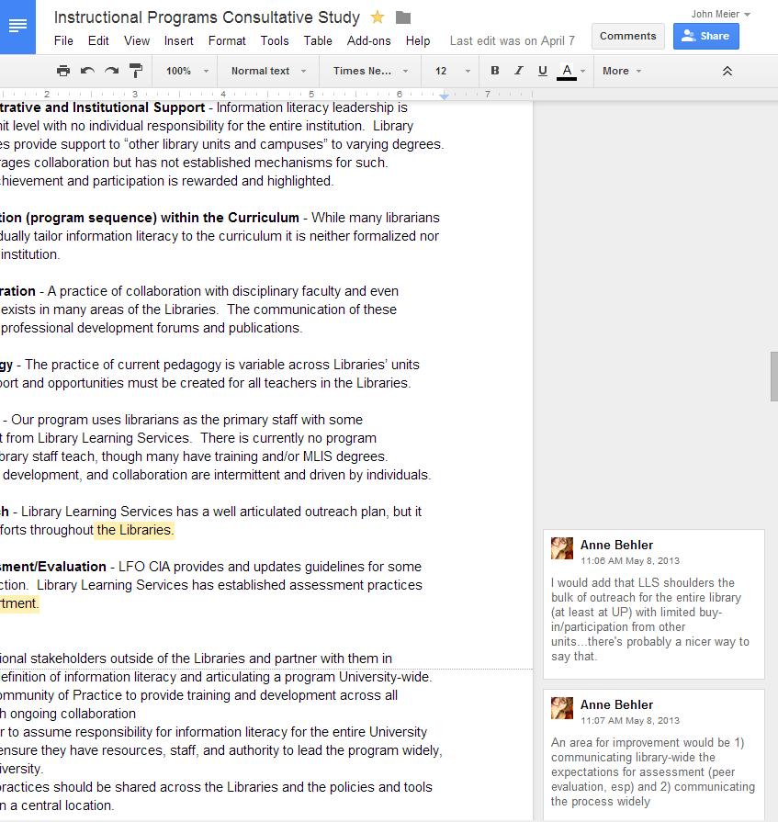
Development of the Report
Timeline = aggressive
Divide and Conquer
Skype and some F2F
Google Docs FTW

Slide 9
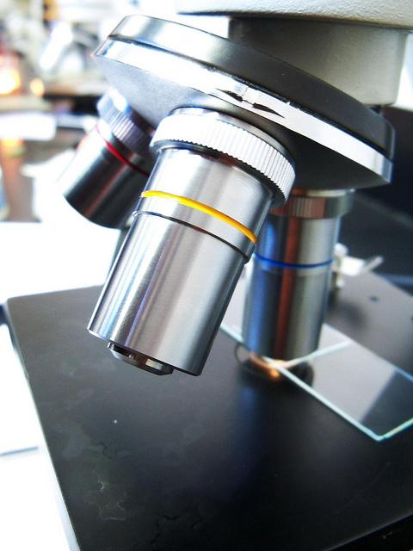
Methodology and Findings
Benchmark against 46 ARL libraries
Review technology
Compare to ACRL Characteristics
Examine peer professional development support
flickr image by Kiran Foster

Slide 10
Recommendations
Identify institutional stakeholders outside of the Libraries and partner with them
Establish a Community of Practice
Select a leader to assume responsibility for information literacy for the entire University Libraries
Assessment practices should be shared

Slide 12
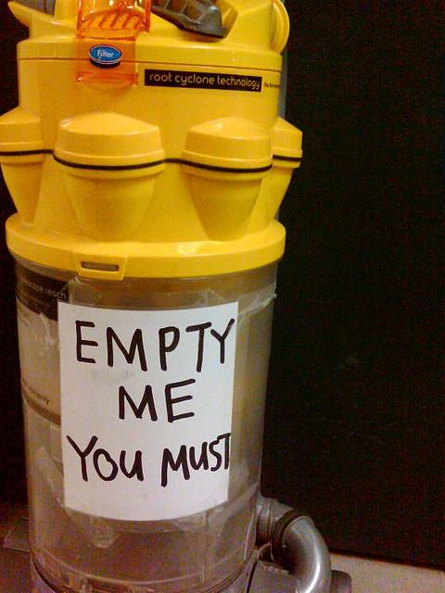
Lessons Learned
Developed in a vacuum
Implementation of other recommendations difficult - requires job changes or extensive buy-in or authority
flickr: Amarand Agasi

Slide 13
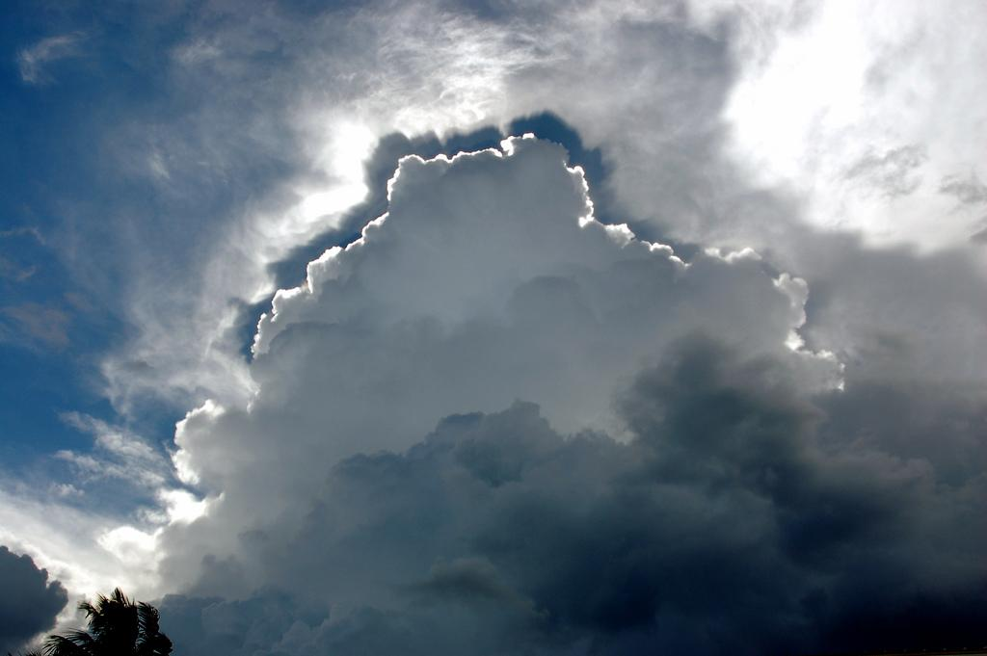
Silver Linings
Community of Practice
Changes for next cohort
Flickr: Mike King

Slide 14
Recommended Reading List
Reframing Academic Leadership book (Bohlman)
ACRL Characteristics of Programs of Information Literacy that Illustrate Best Practices
Moving Forward Report https://scholarsphere.psu.edu/files/sf268b978
Michigan’s Instructor College Cafehttp://open.umich.edu/node/5748
Penn State University Libraries Community of Practice http://sites.psu.edu/psulcop

